Slide 1
2020 RTEP Report
Key Maps, Tables & Figures
The following set of slides provides key information from PJM’s 2020 RTEP cycle. The slides are provided for the reader’s own communications needs.

Slide 2
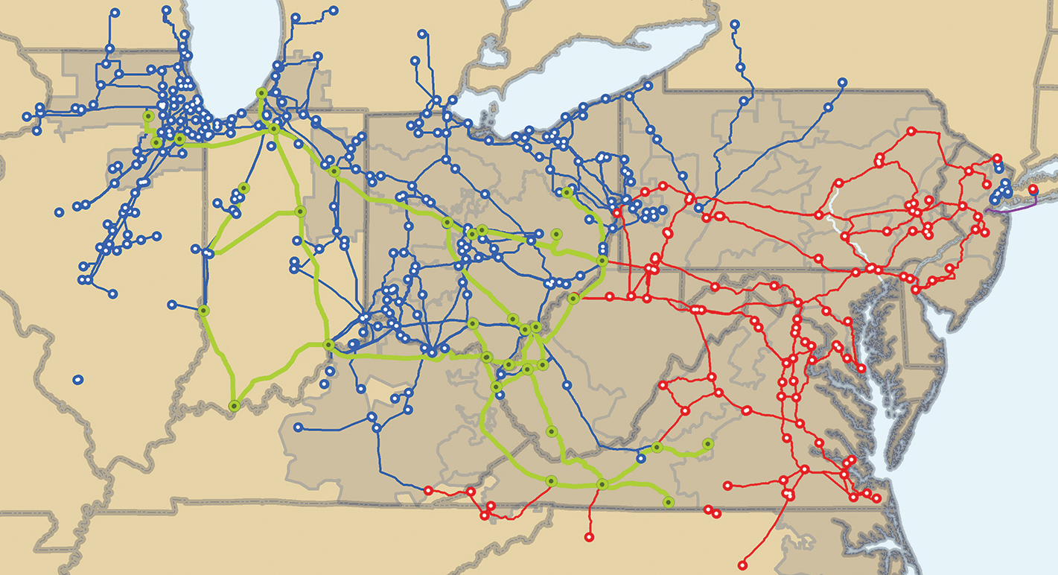
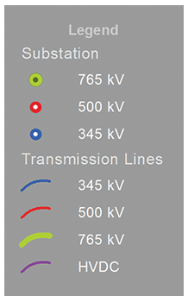
PJM Backbone Transmission System

Slide 3
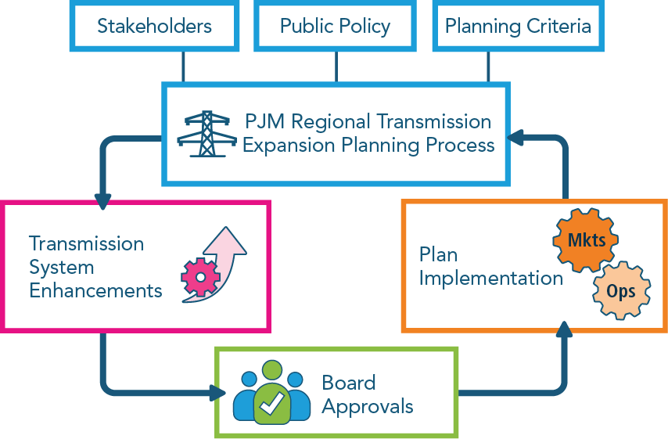
RTEP Process – RTO Perspective

Slide 4
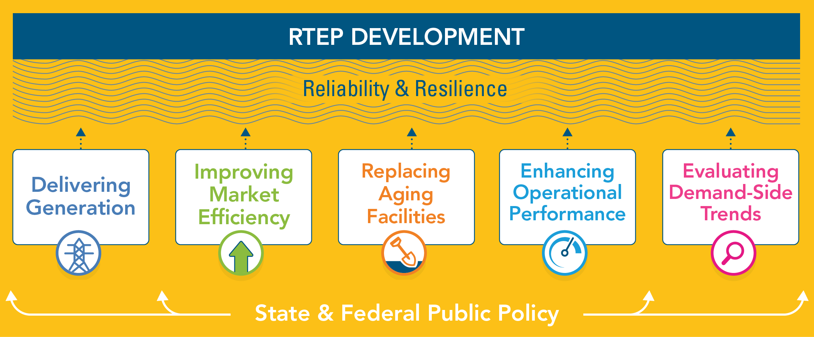
System Enhancement Drivers

Slide 5
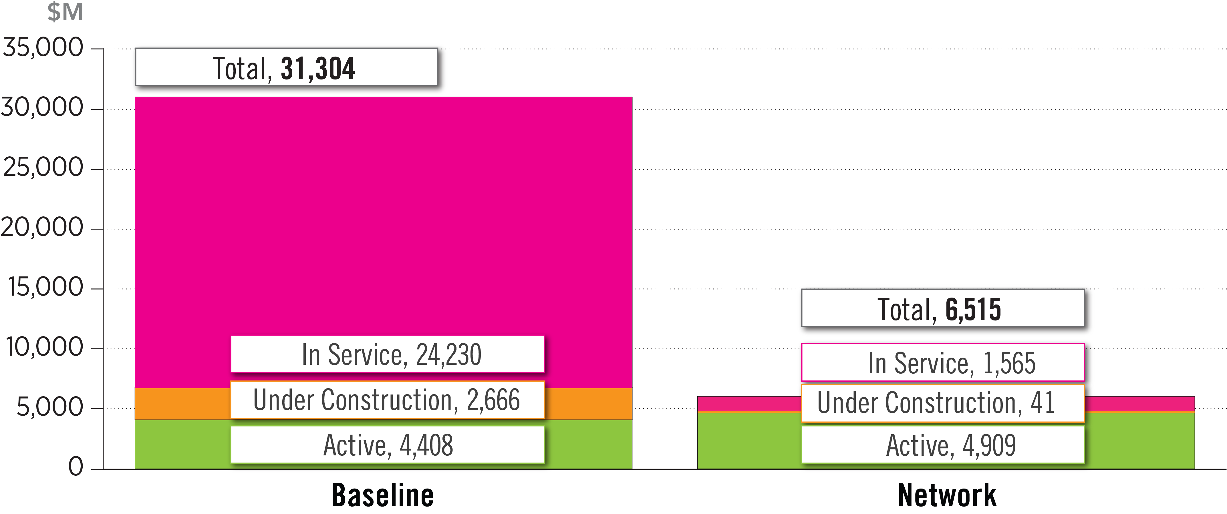
Board Approved RTEP Projects
(as of Dec. 31, 2020)

Slide 6
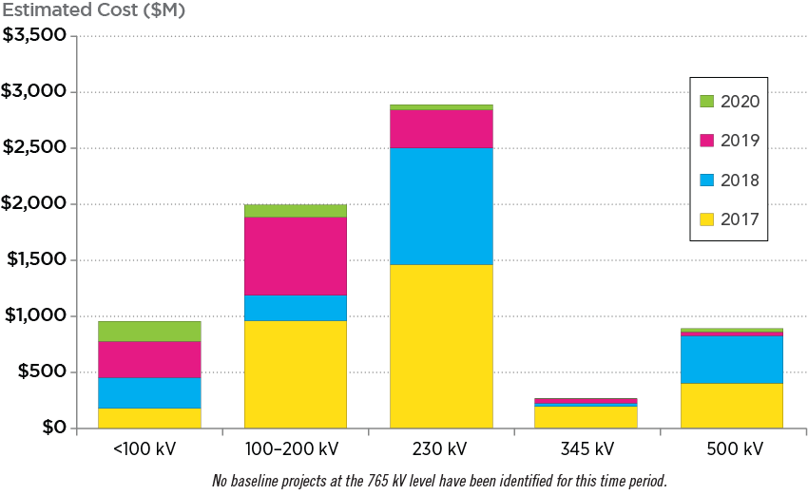
Approved Baseline Projects by Voltage
(2016-2020)

Slide 7
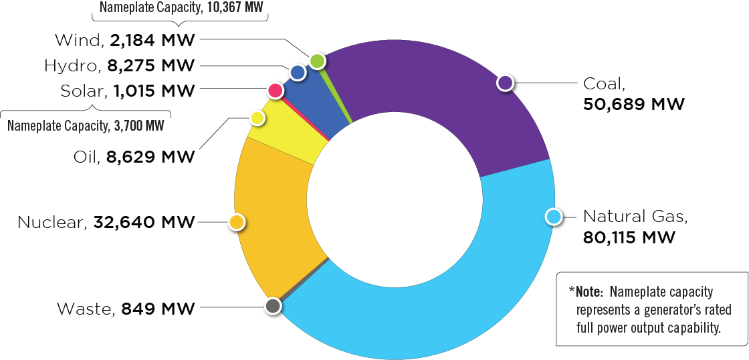
PJM Existing RPM-Eligible Installed Capacity Mix
(Dec. 31, 2020)

Slide 8
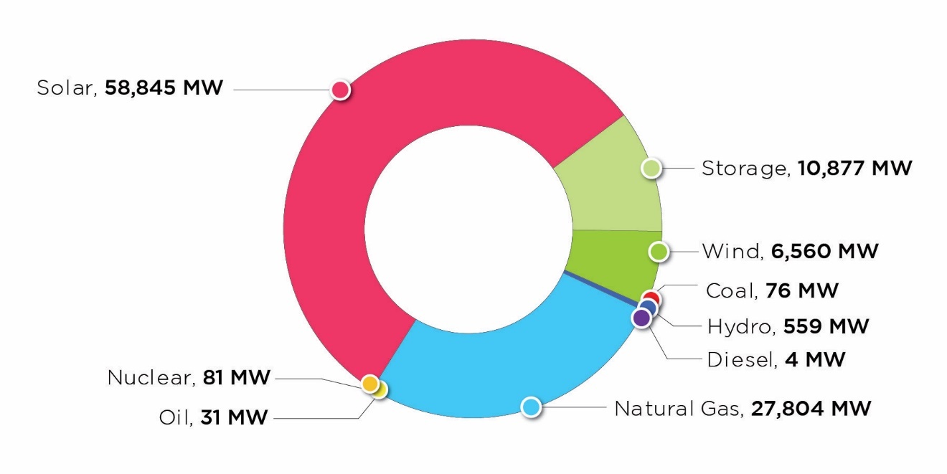
PJM Queued Generation Fuel Mix – Requested
Capacity Interconnection Rights
(Dec. 31, 2020)

Slide 9
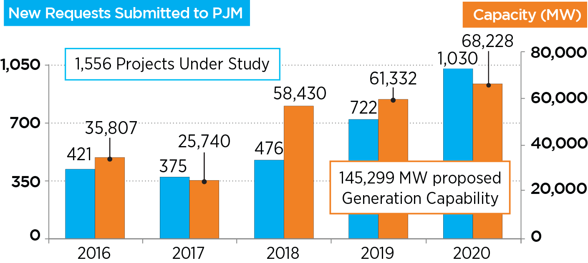
Growth of Renewables in PJM Queue

Slide 10

Generator Deliverability Concept

Slide 11
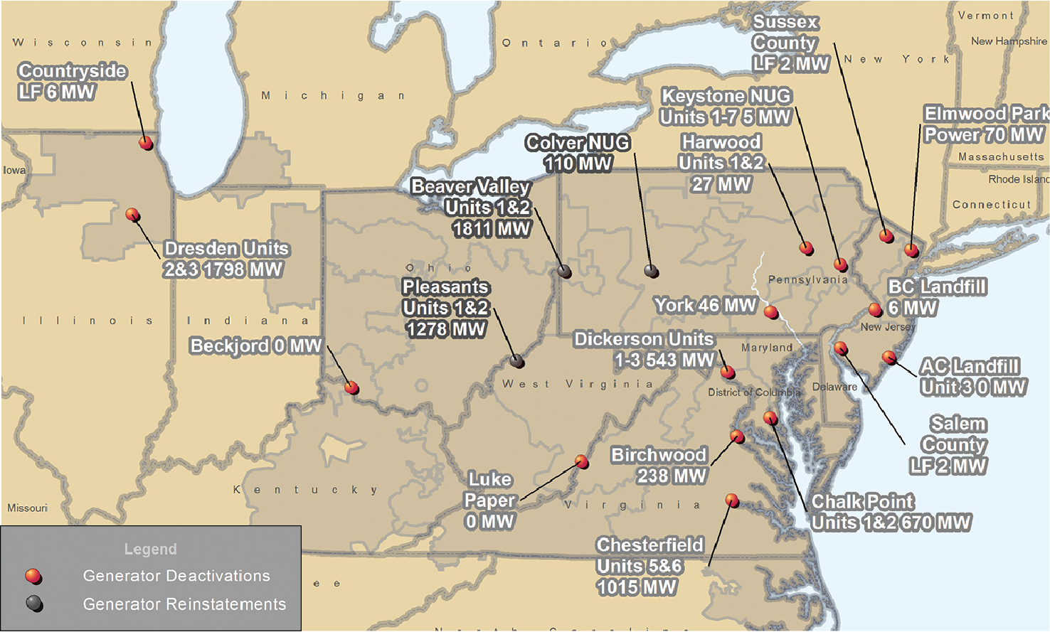
PJM Generator Deactivation Notifications Received
Jan. 1, 2020−Dec. 31, 2020

Slide 12
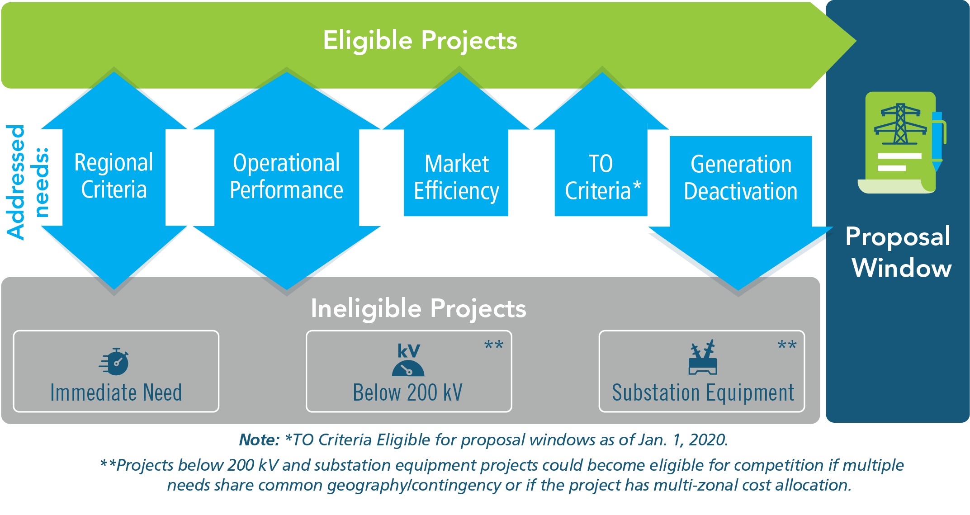
RTEP Proposal Window Eligibility

Slide 13
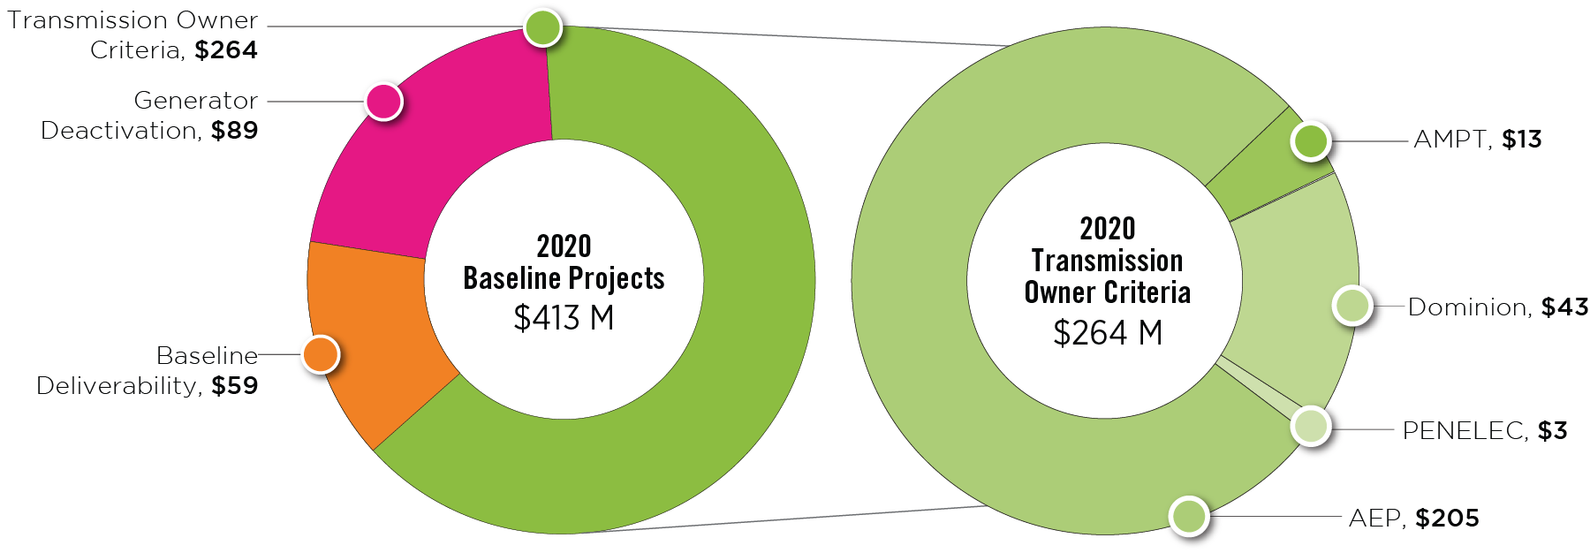
2020 RTEP Baseline Projects by Driver
($ Million)

Slide 14
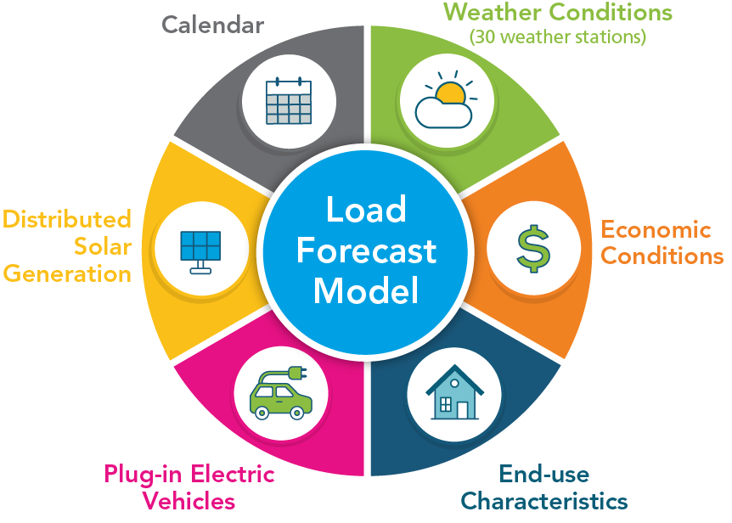
Load Forecast Model

Slide 15
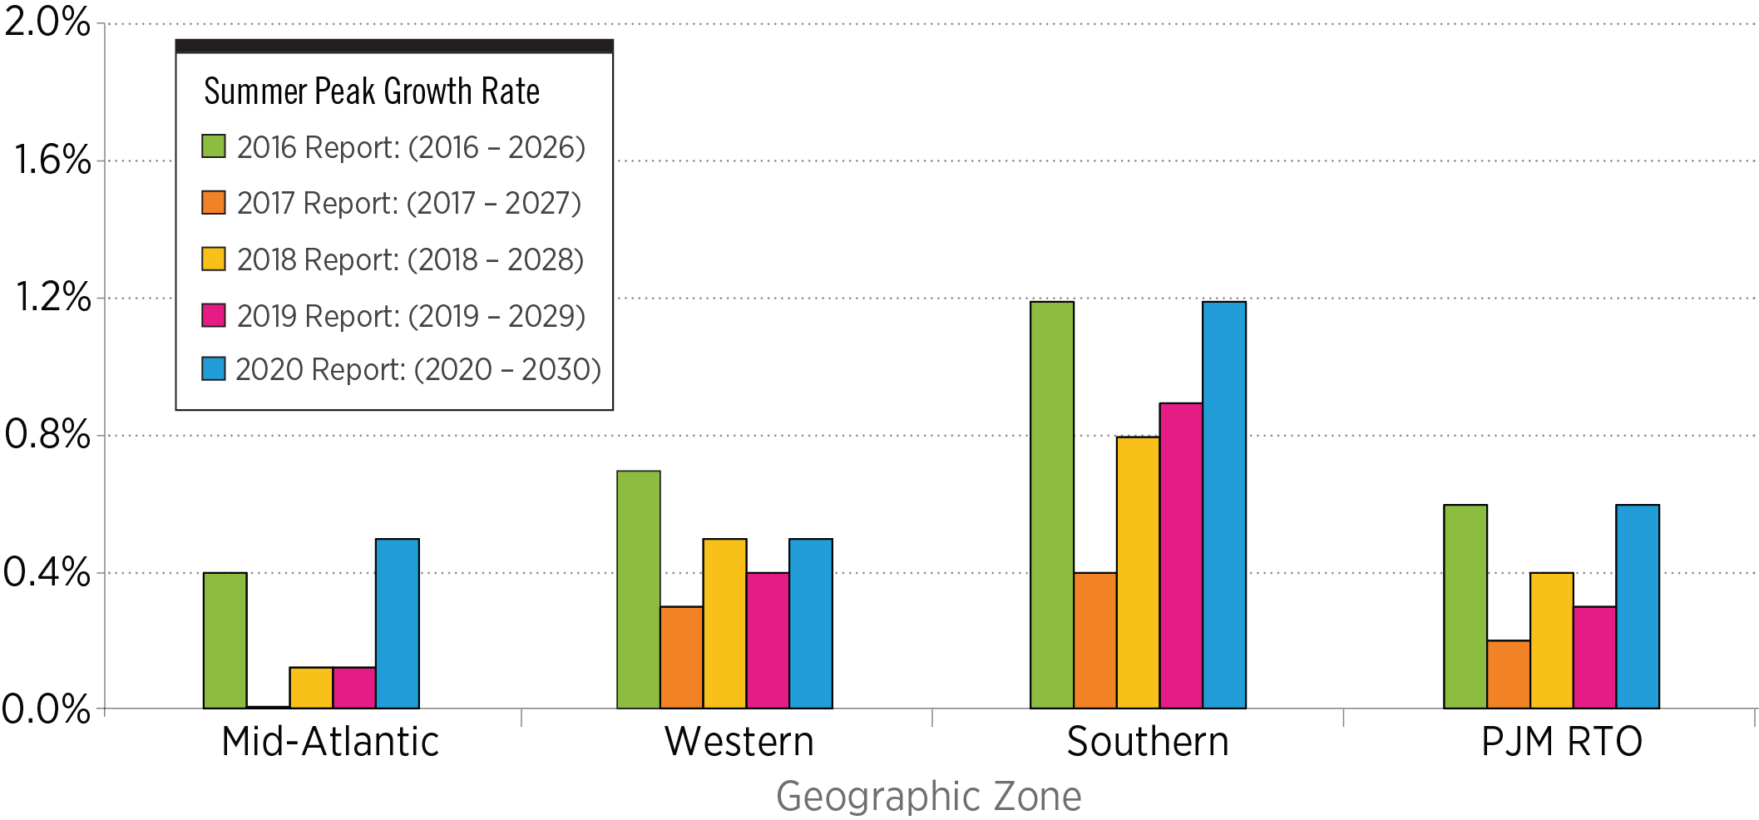
PJM 10-Year Summer Peak Load Growth Rate Comparison
2016-2020 Load Forecast Reports

Slide 16
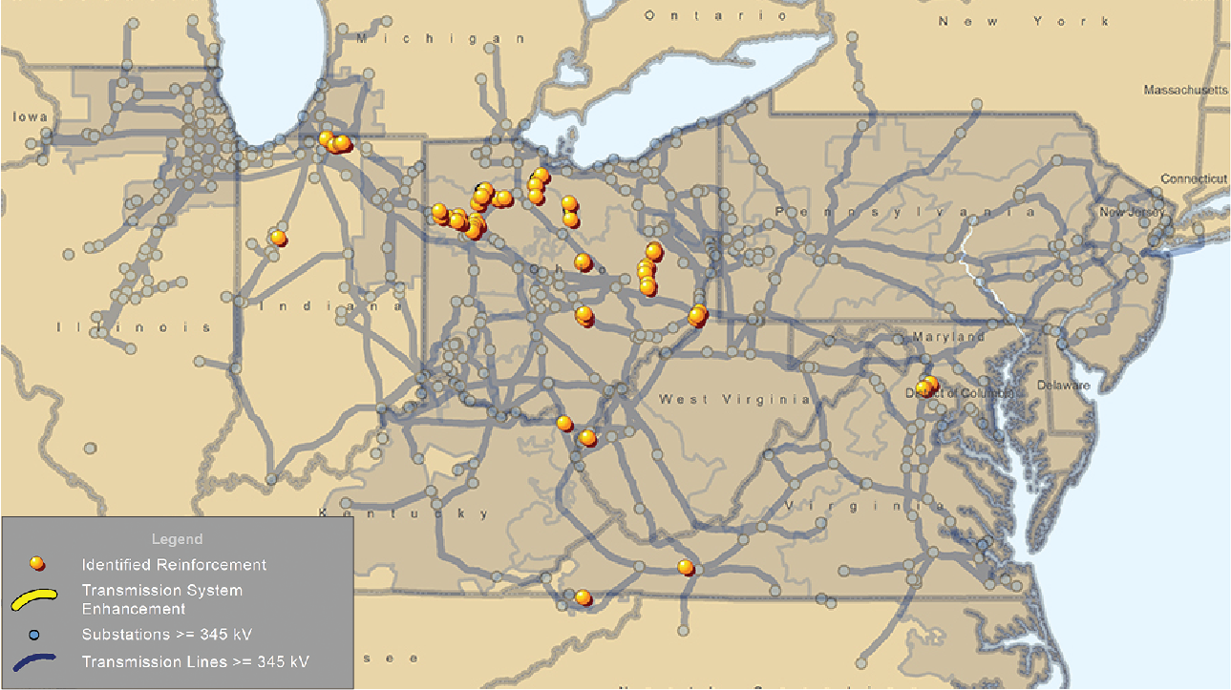
2020 RTEP Baseline Thermal and Voltage Criteria Violations

Slide 17
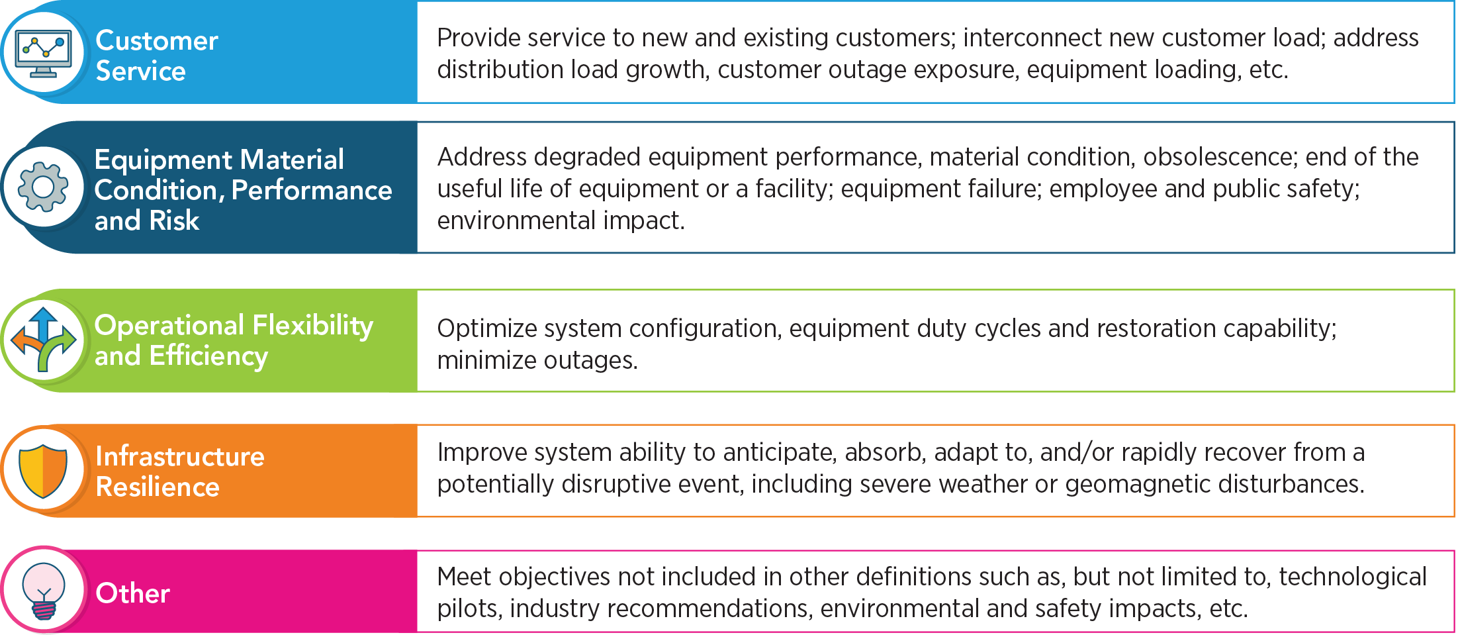
Primary Supplemental Project Drivers

Slide 18
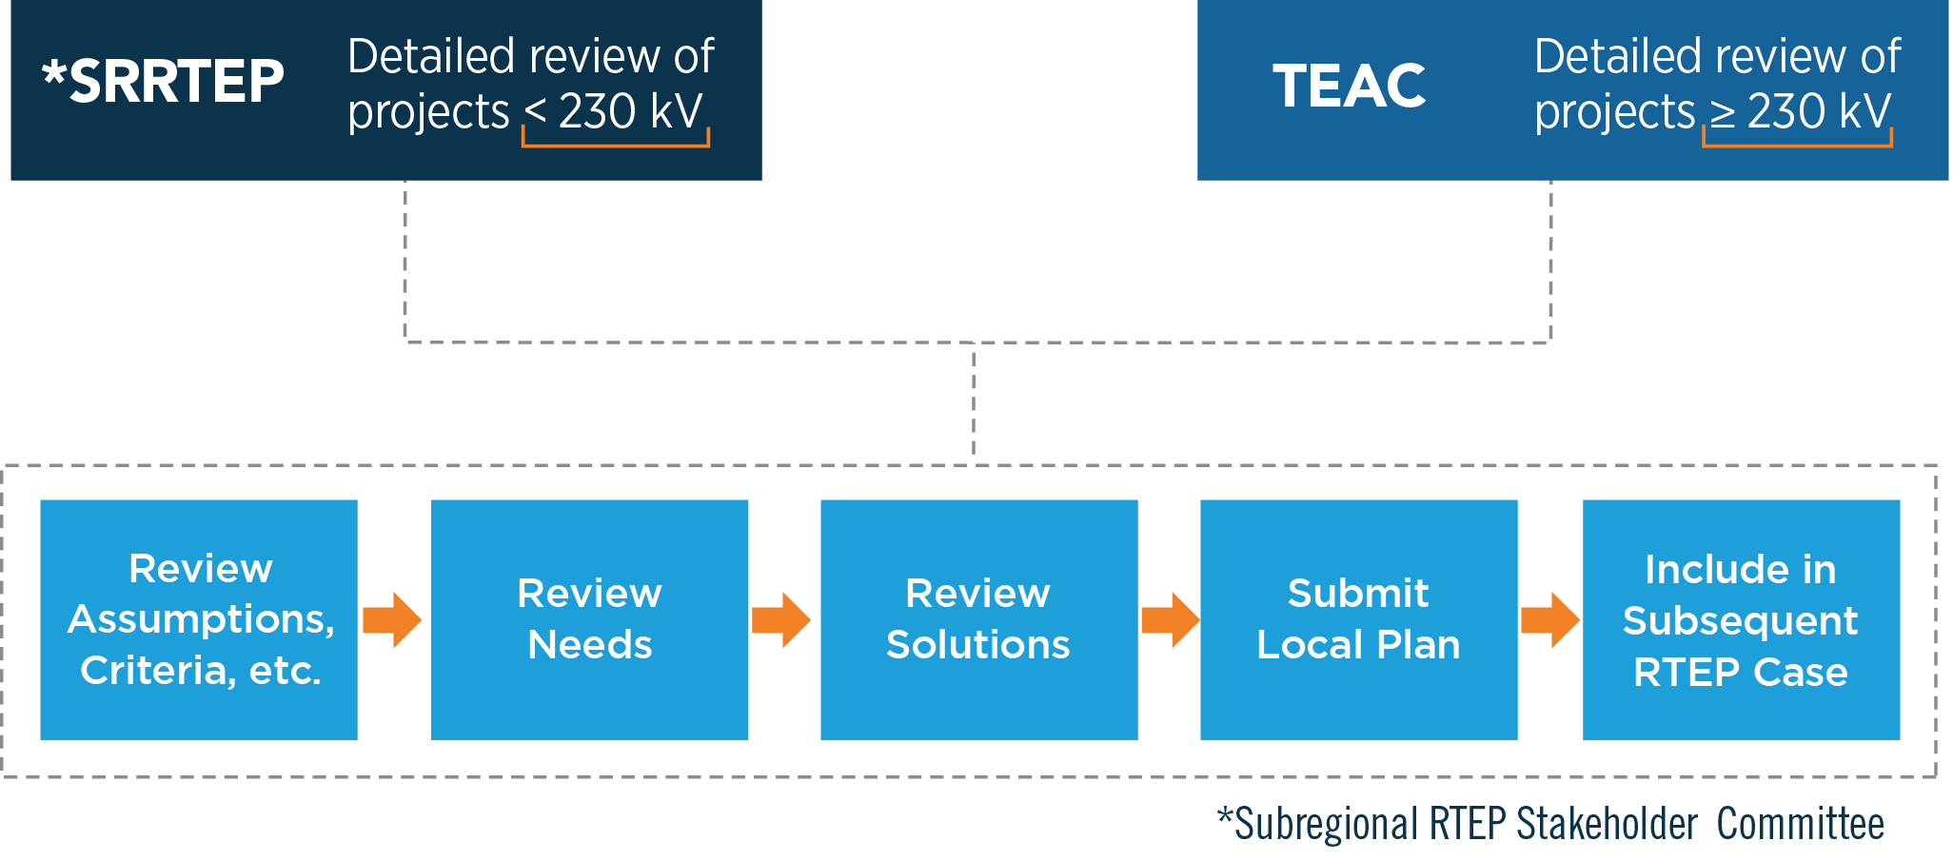
Attachment M-3 Process for Supplemental Projects

Slide 19
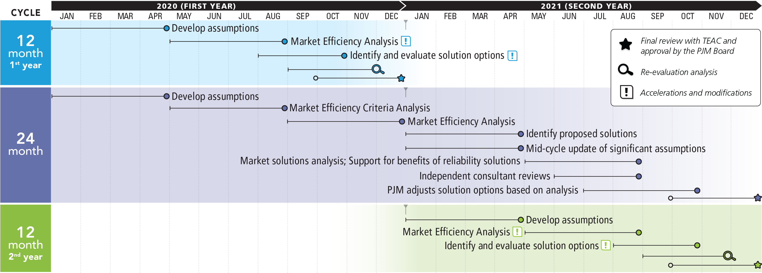
2020/2021 Market Efficiency 24-Month Cycle

Slide 20
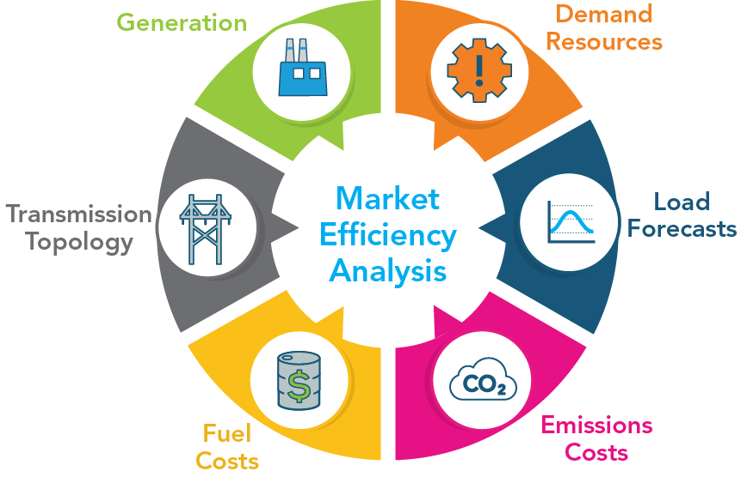
Market Efficiency Analysis Parameters

Slide 21

Project 9A – RTEP Baseline Projects B2743 and B2752

Slide 22
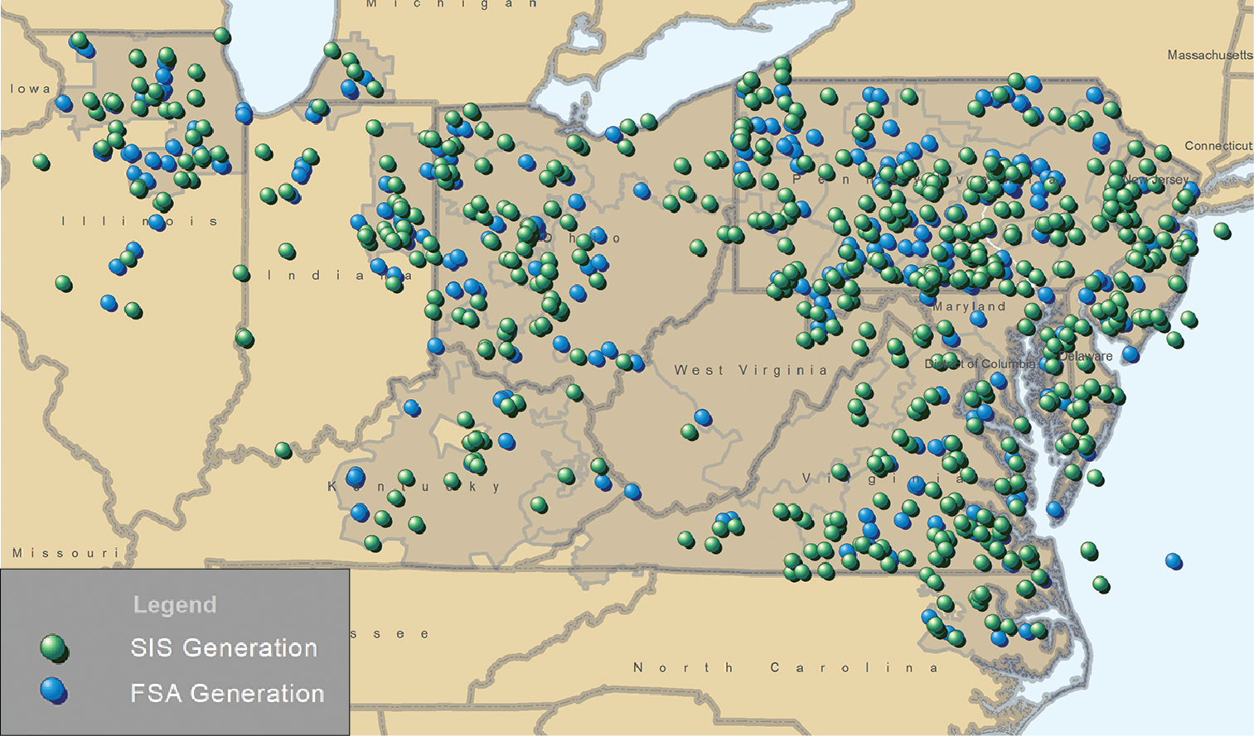
Feasibility and System Impact Studies Performed in 2020

Slide 23
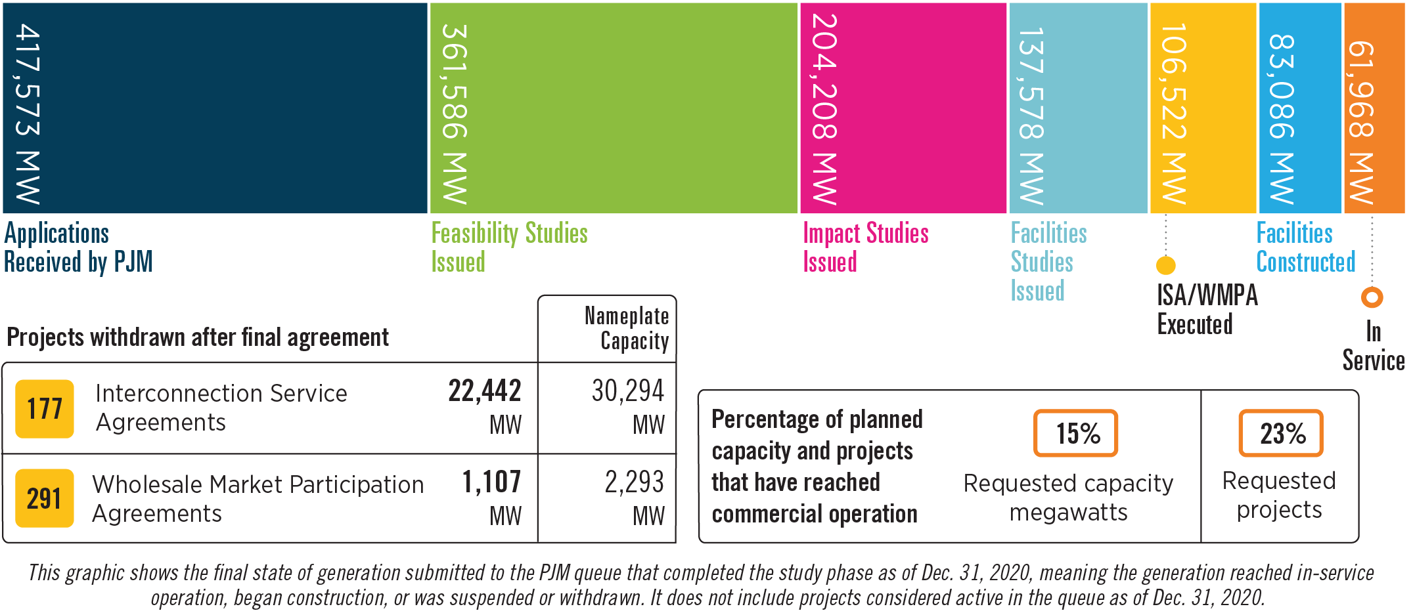
Queued Generation Progression –
Requested Capacity Rights (Dec. 31, 2020)

Slide 24
New Services Queue Process Overview

