Slide 1
2021 RTEP Report
Key Maps, Tables & Figures
The following set of slides provides key information from PJM’s 2021 RTEP cycle. The slides are provided for the reader’s own communications needs.

Slide 2
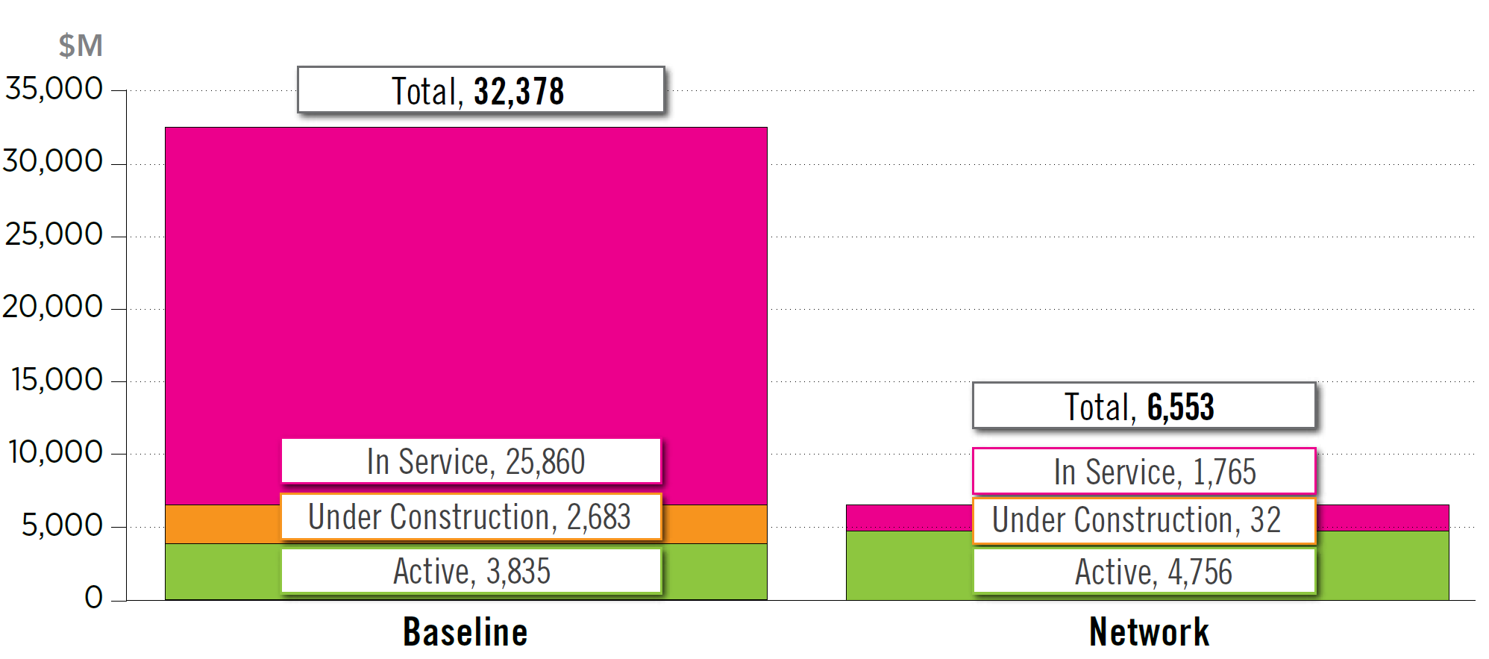
Board Approved RTEP Projects
(as of Dec. 31, 2021)

Slide 3
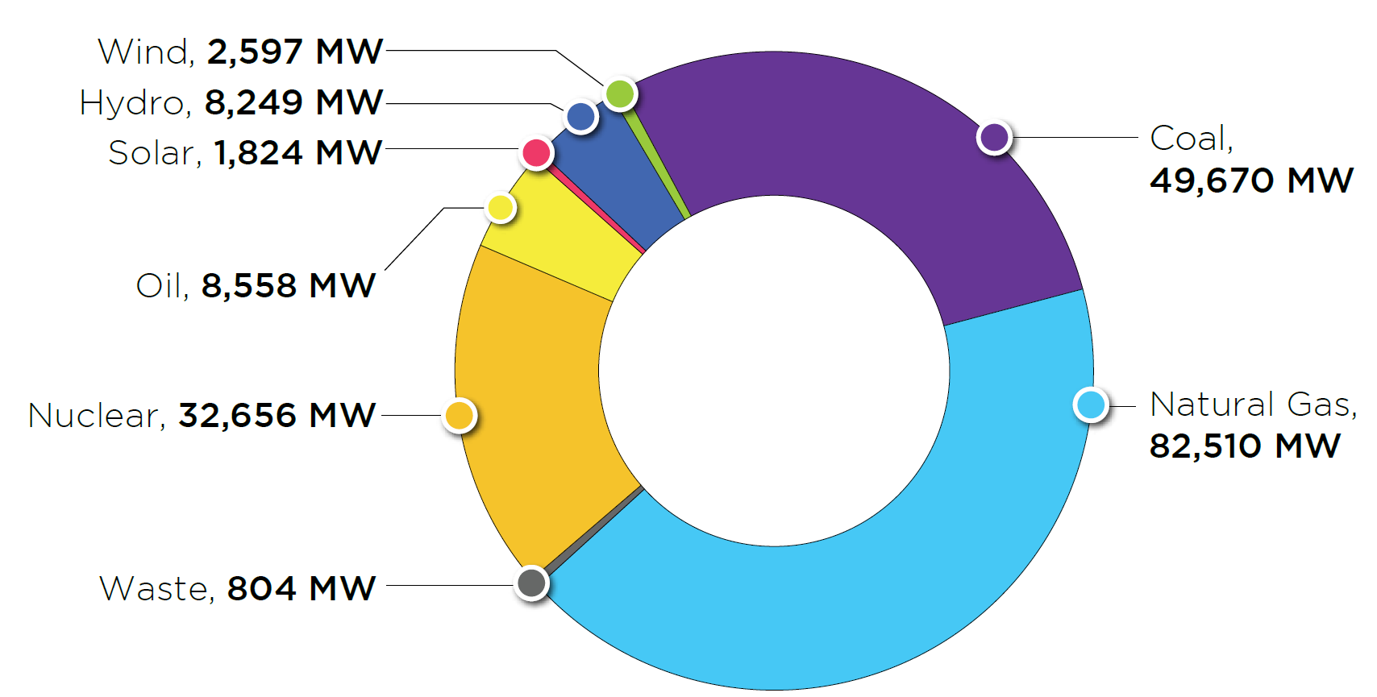
PJM Existing RPM-Eligible Installed Capacity Mix
(Dec. 31, 2021)

Slide 4
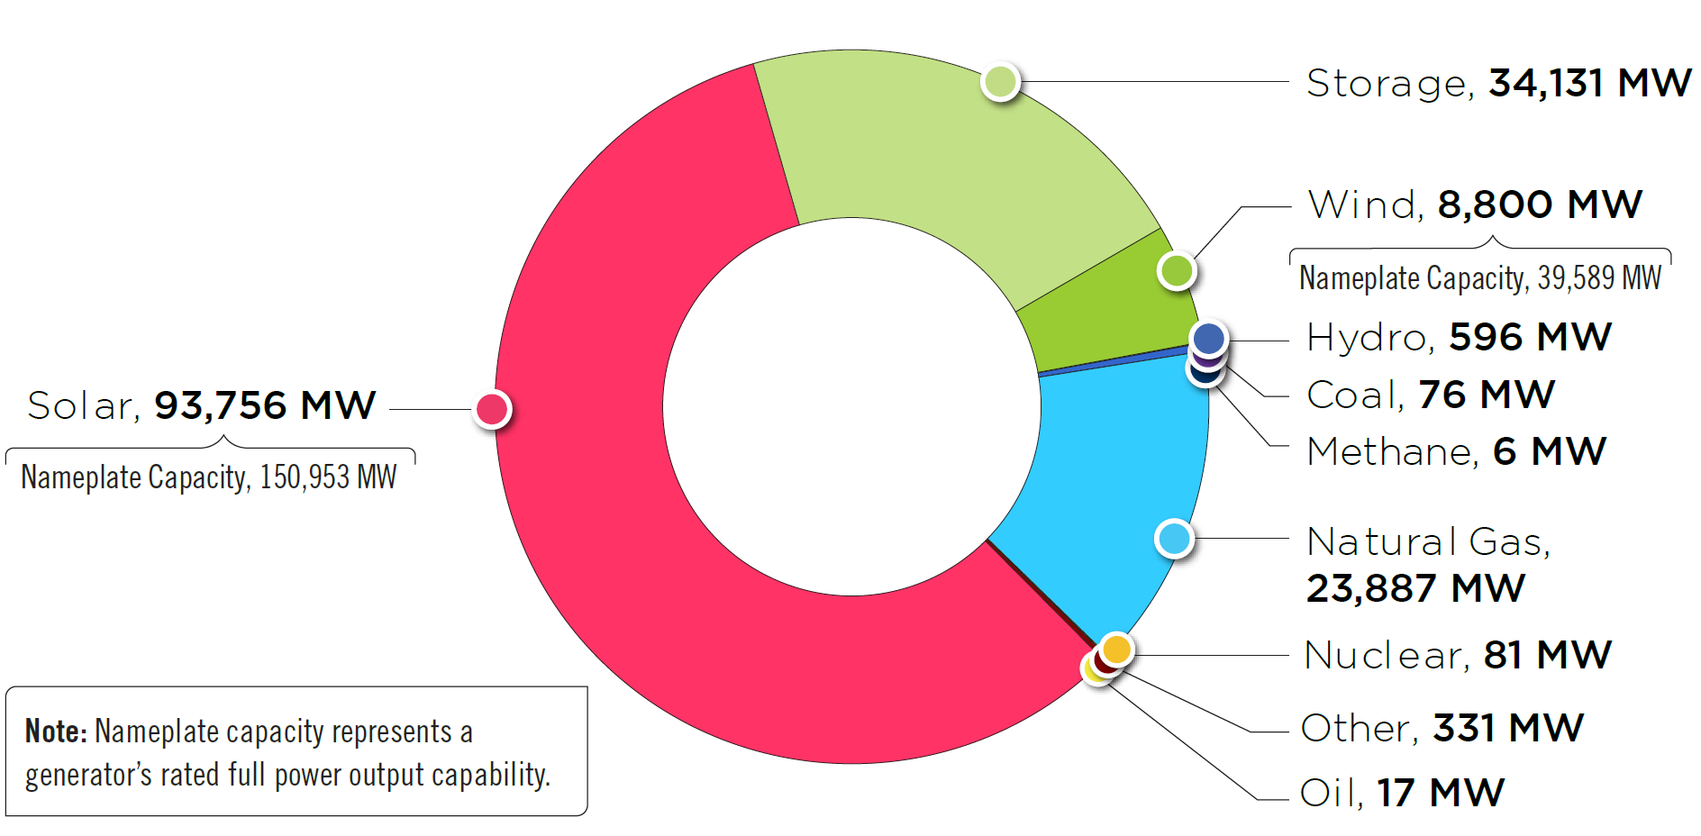
PJM Queued Generation Fuel Mix – Requested
Capacity Interconnection Rights
(Dec. 31, 2021)

Slide 5
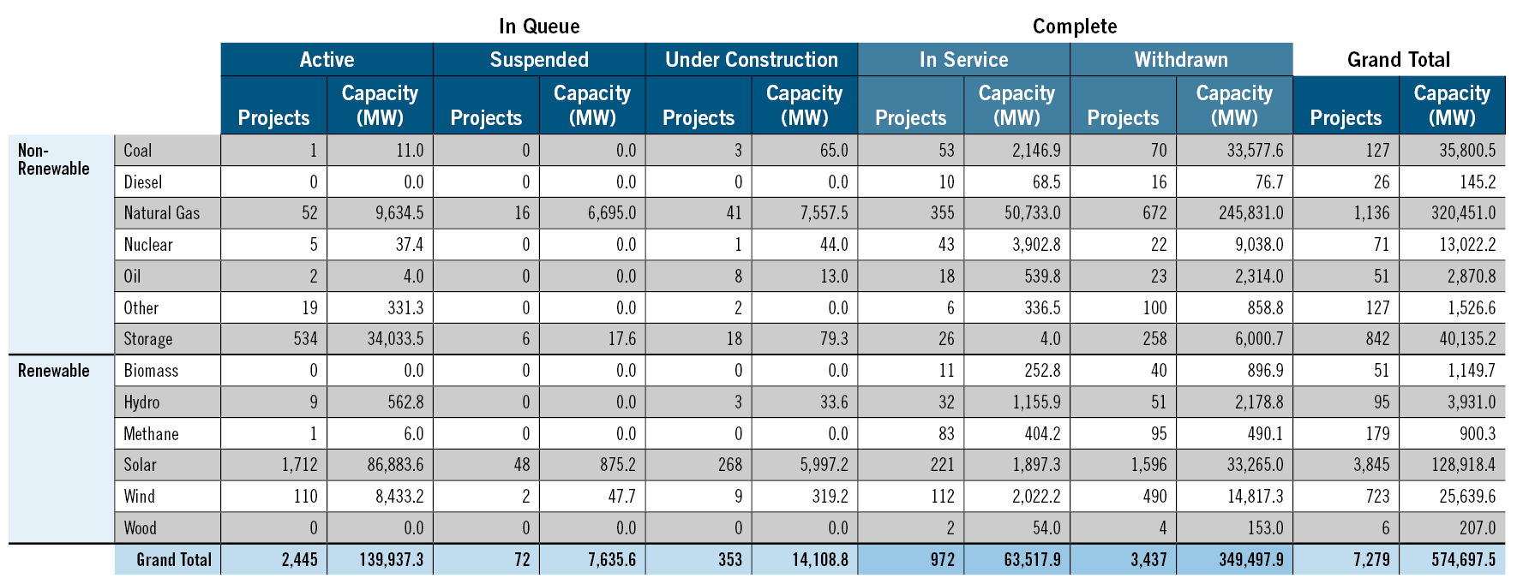
Requested Capacity Interconnection Rights,
Non-Renewable and Renewable Fuels (Dec. 31, 2021)

Slide 6
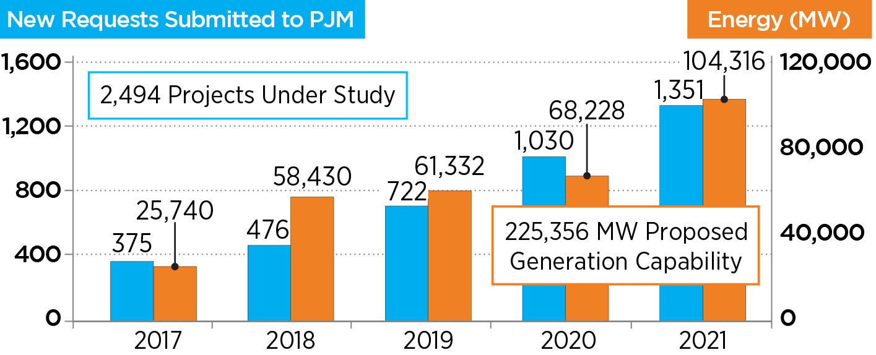
Growth of Renewables in PJM Queue

Slide 7
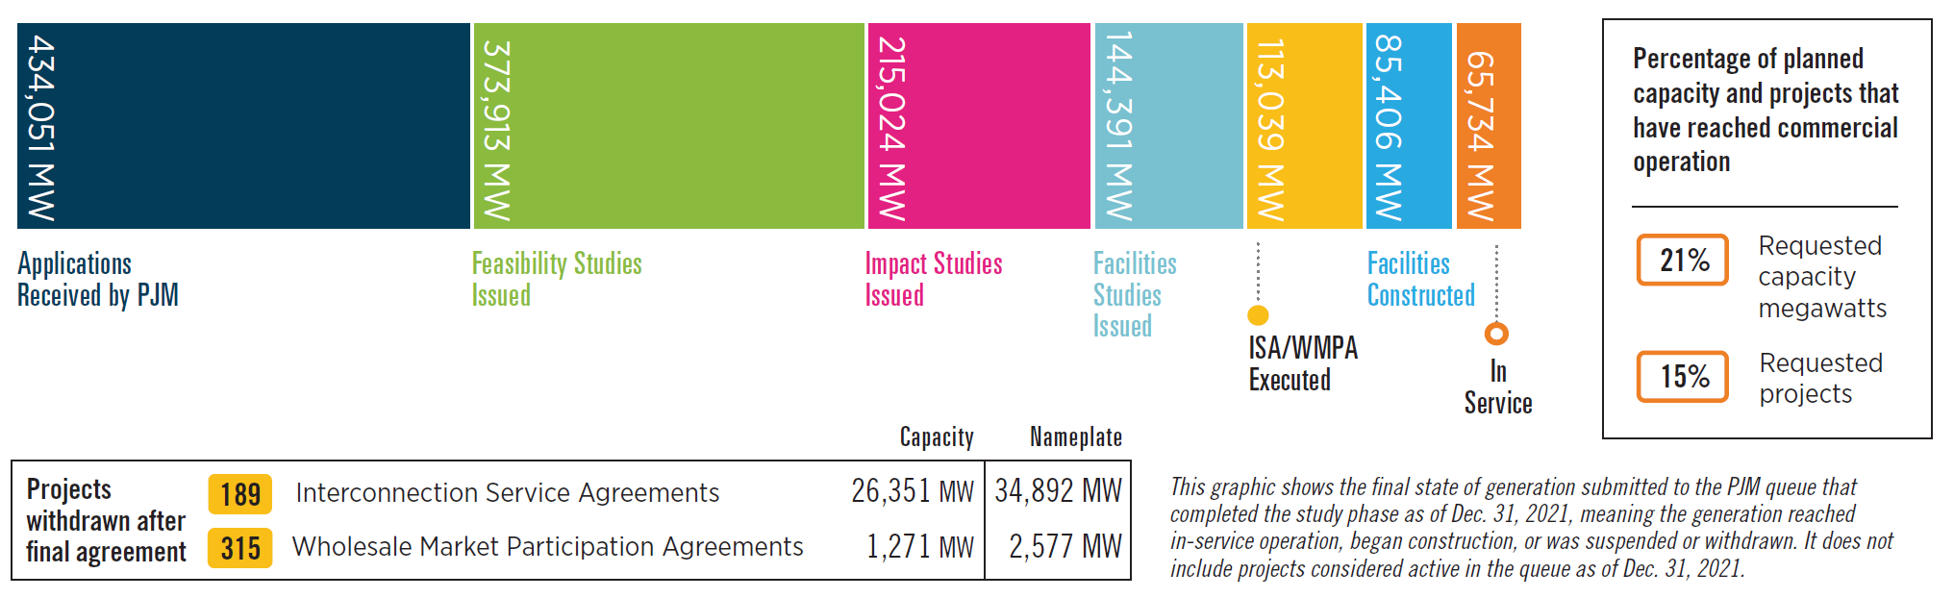
Queued Generation Progression –
Requested Capacity Rights (Dec. 31, 2021)

Slide 8
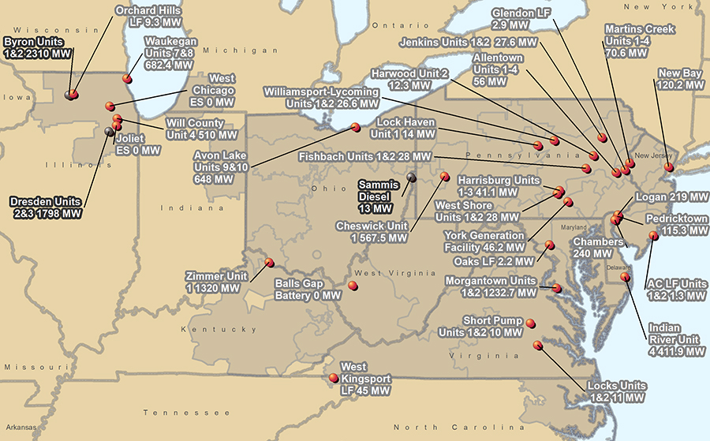

PJM Generator Deactivation Notifications Received
Jan. 1, 2021−Dec. 31, 2021

Slide 9
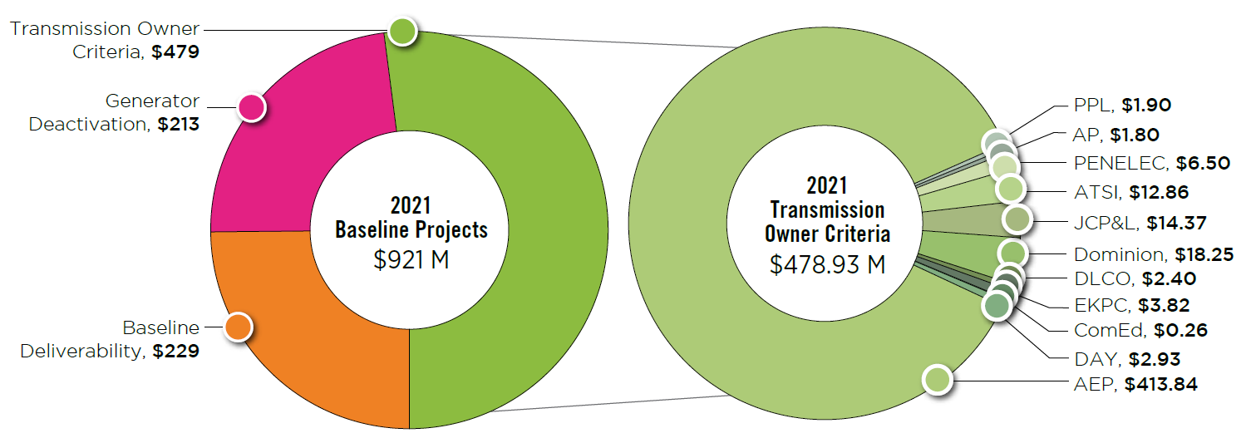
2020 RTEP Baseline Project Driver ($ Million)

Slide 10
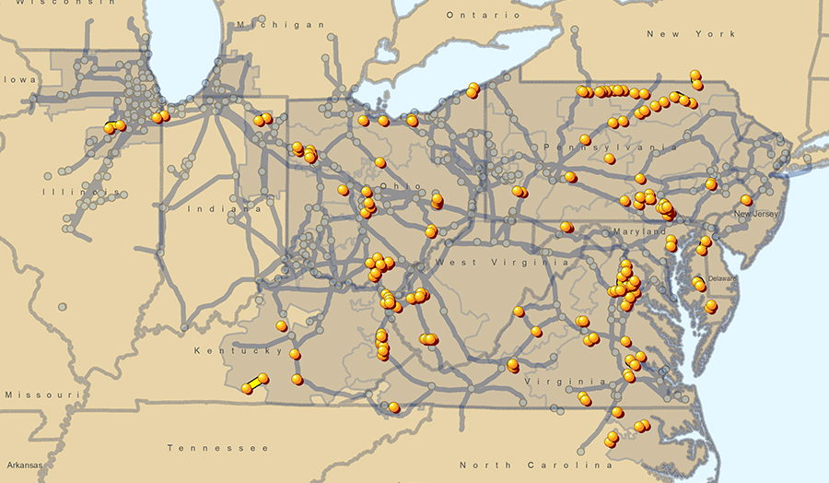
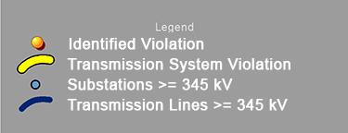
2021 RTEP Baseline Thermal and Voltage Criteria Violations

Slide 11
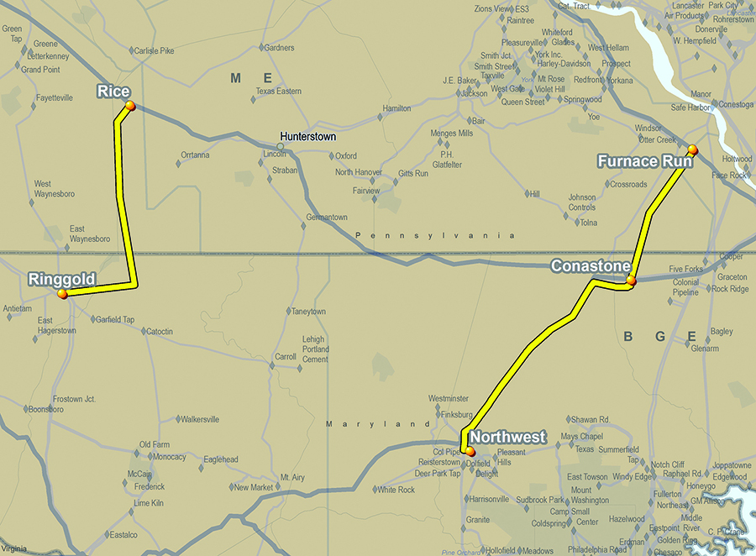
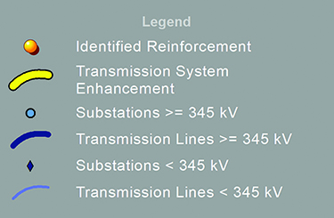
Project 9A – RTEP Baseline Projects B2743 and B2752

Slide 12
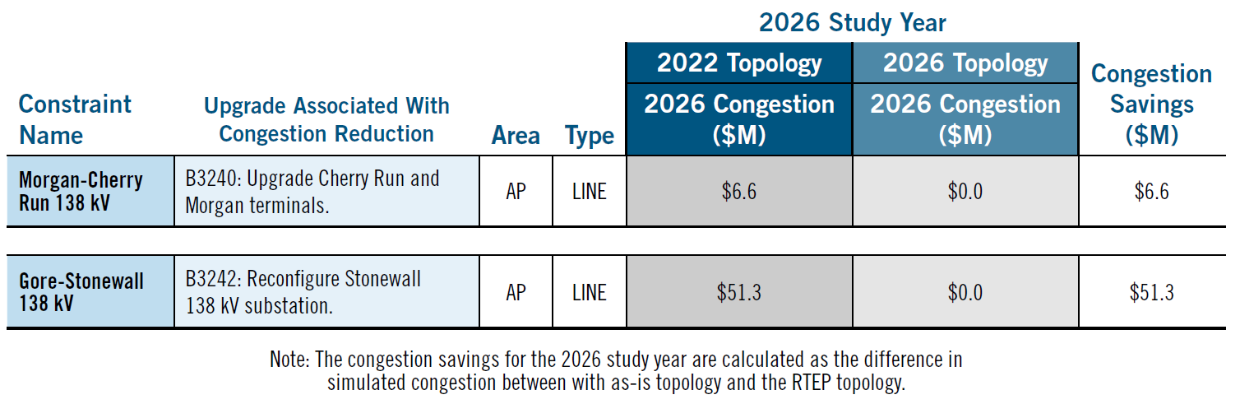
RTEP Projects Reducing Specific Congestion Drivers:
2026 Analysis

Slide 13
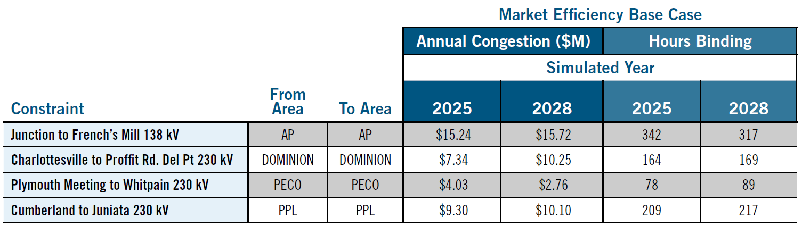
2020/2021 Long-Term Window Congestion Drivers

Slide 14
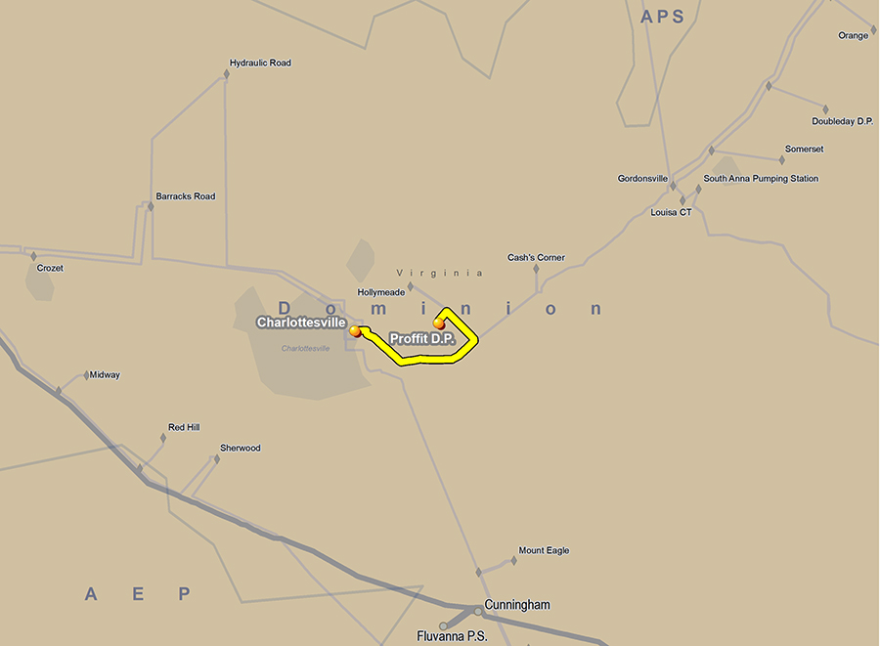

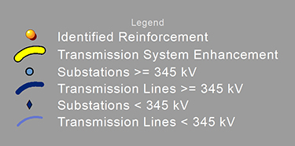
Baseline Project B3702: Charlottesville-Proffit 230 kV Line
Series Reactor

Slide 15
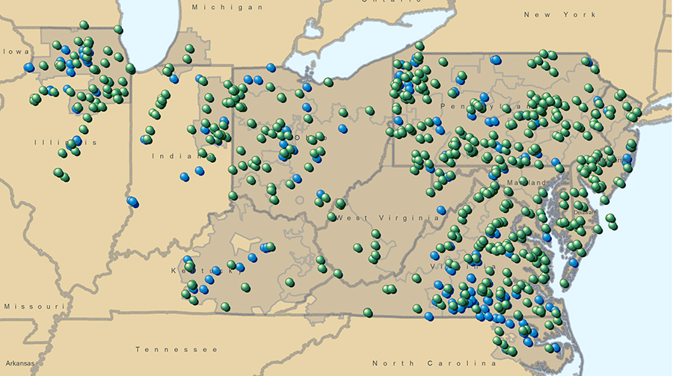
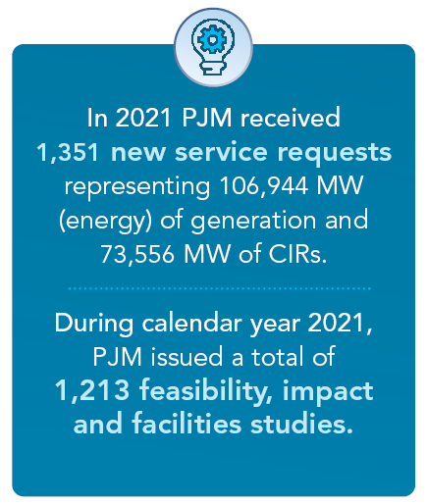

Feasibility and System Impact Studies Performed in 2021

Slide 16
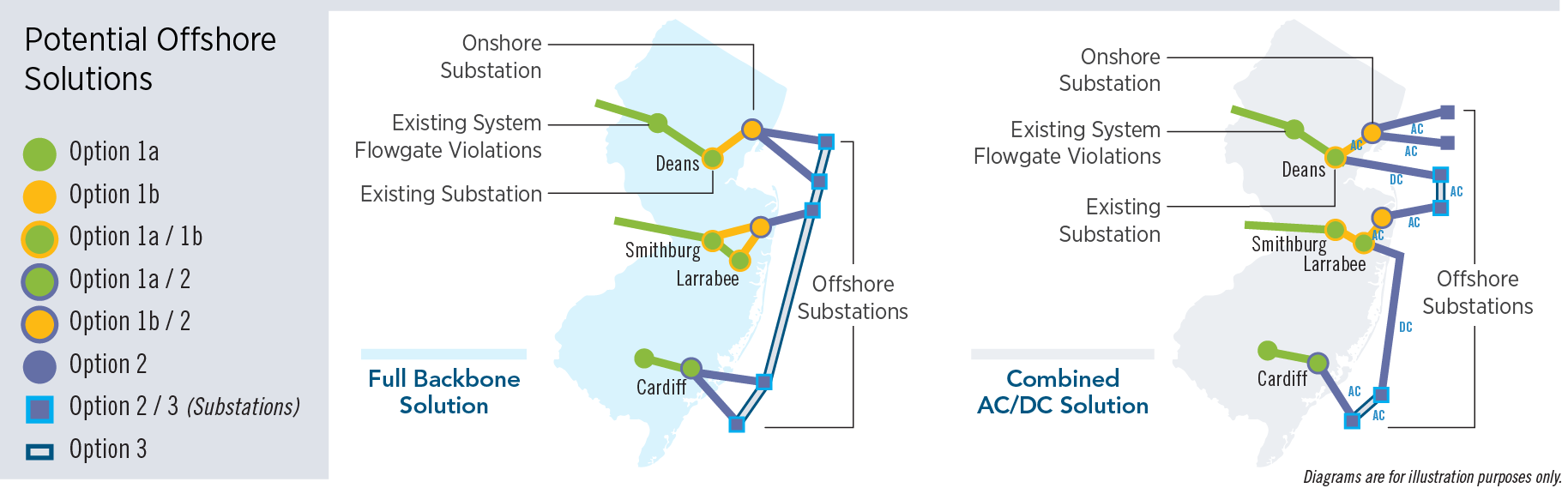
New Jersey Offshore Wind Potential Solutions

Slide 17
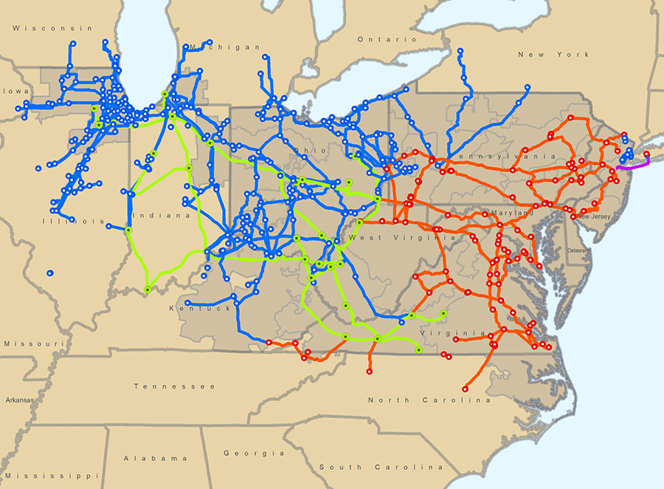
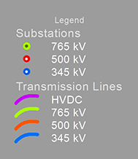
PJM Backbone Transmission System

